Slide 1
CSE 528: Project Presentation
Course Instructor: Dr. Donghoon Chang
Project Members:
Varun Upadhyay, 2019285
Nikhil Kushwah, 2019260
Rohit Kumar Vishwas, 2019269

Slide 2
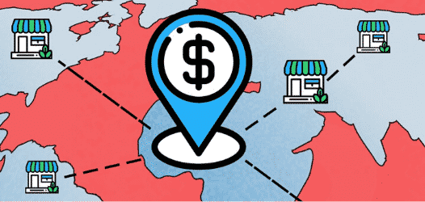
OUR PROJECT
A DECENTRALIZED BANKING AND STAKING SYSTEM

Slide 3
LINK TO VIDEO
**Click the above text**

Slide 4
Problem Statement and Overview of Project

Slide 5
FF-Bank is a decentralized bank which leverages the use of digital contracts while interacting with blockchains. This serves as a financial institution without any banks or brokers. The decentralized application runs on the Ethereum network using blockchain technology, this makes the banking completely decentralized.
For currency we have our own custom Token which has an initial total surplus, and a reward is assigned whenever some user deposits their own tokens in the DecentralizedBank.

Slide 6


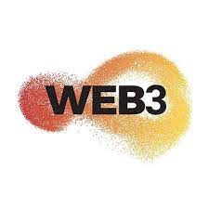
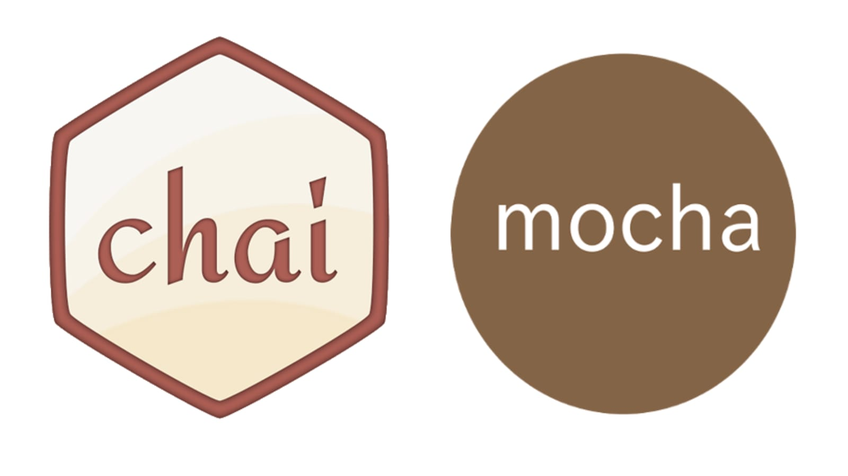
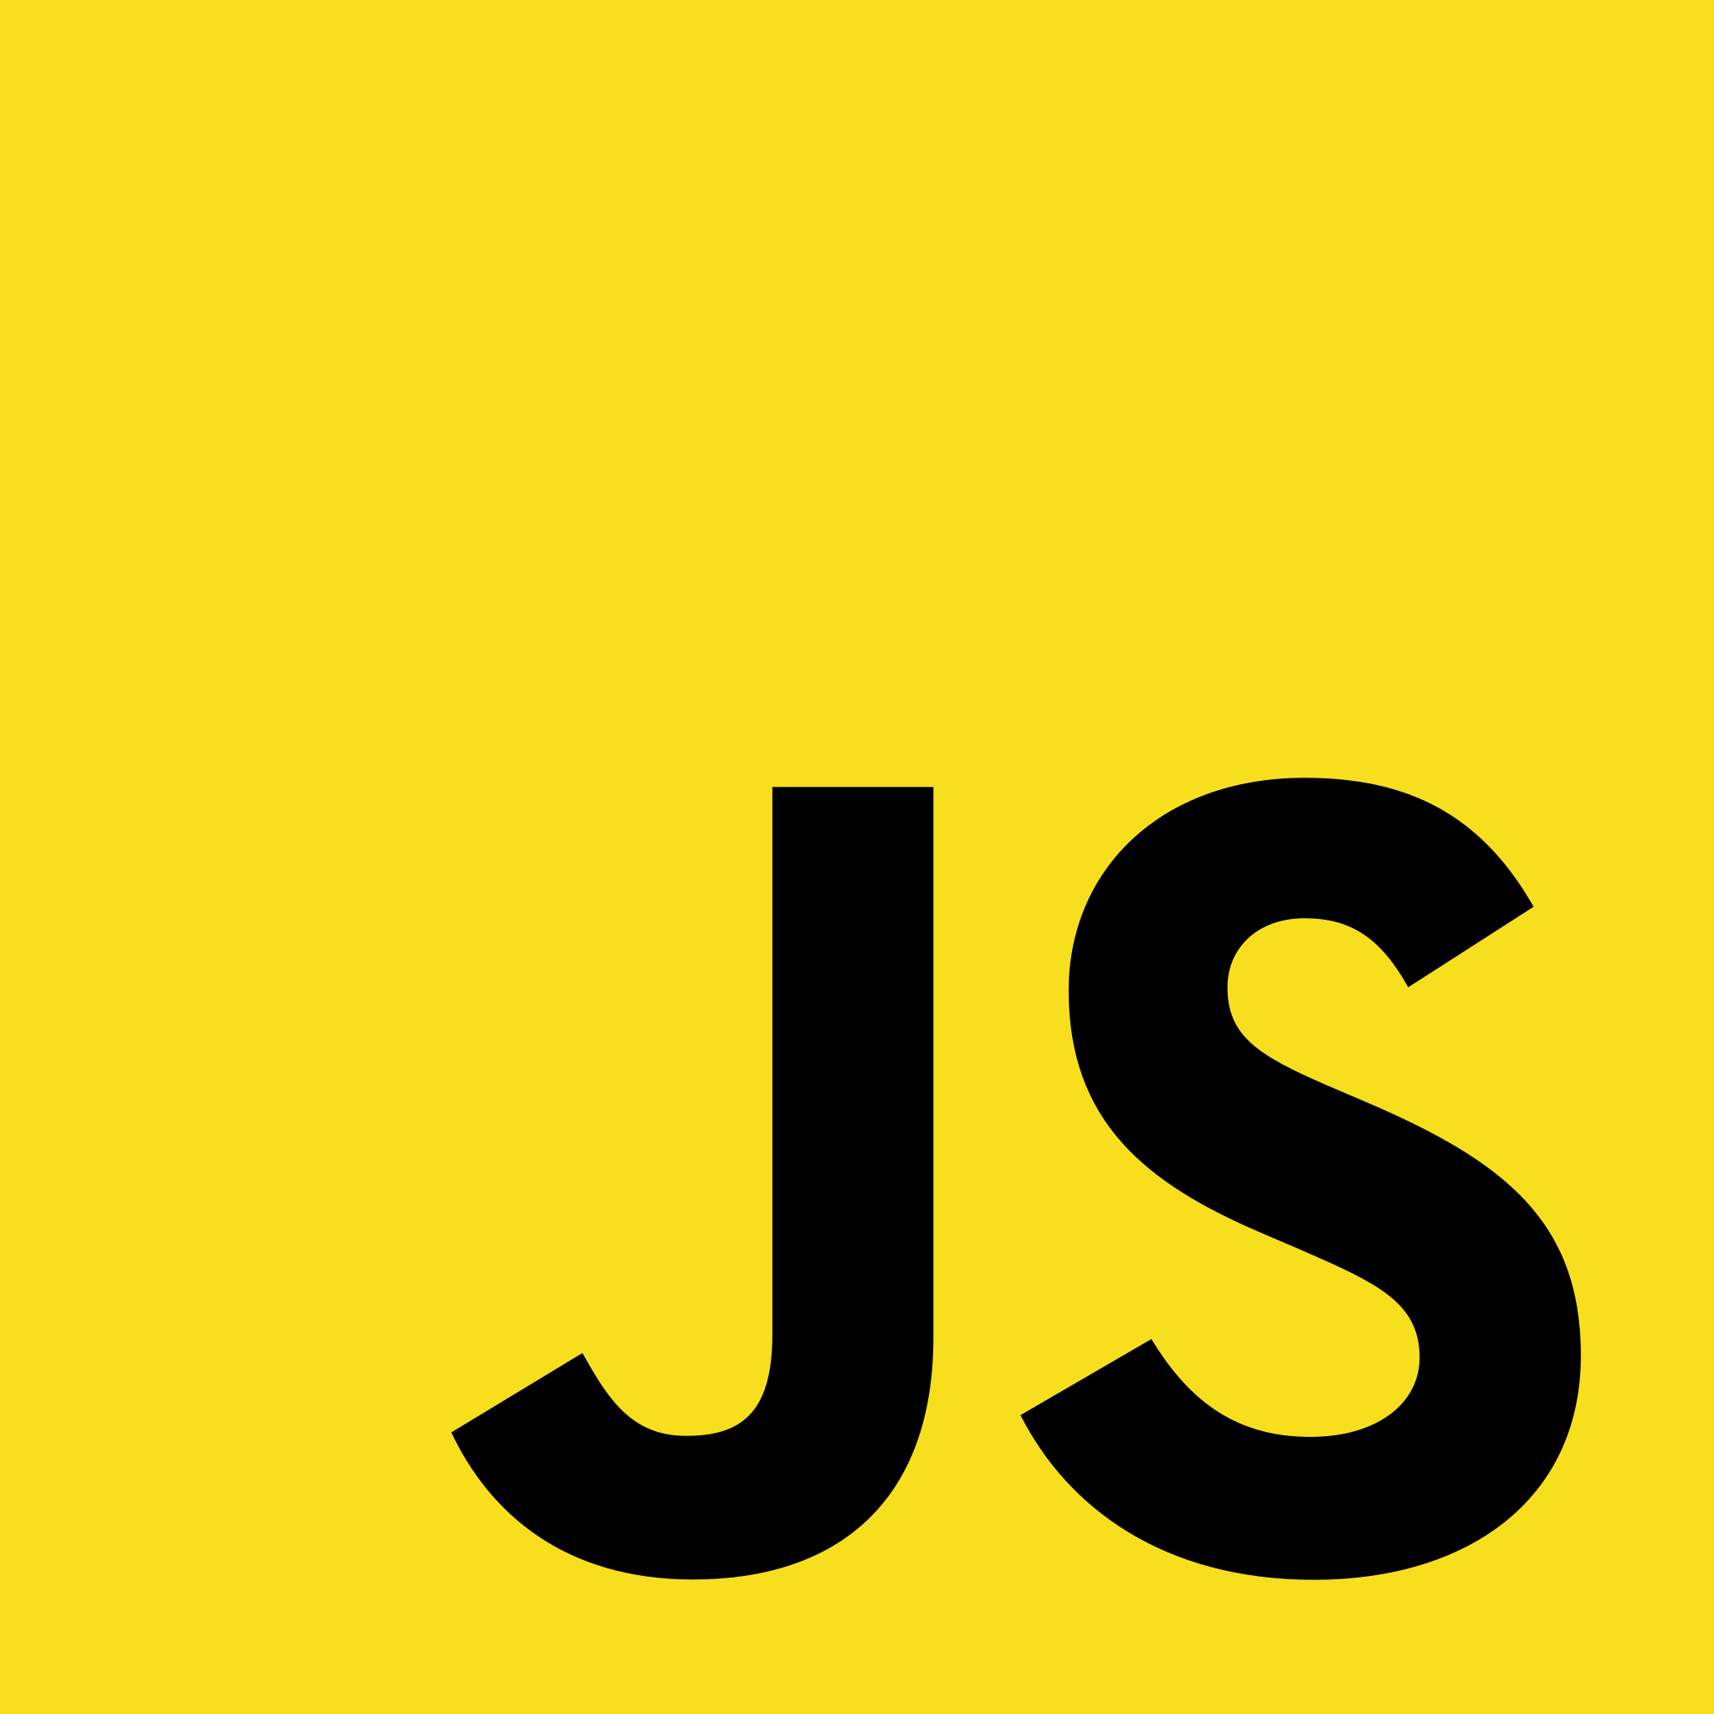



Tech Stack Used

Slide 7
CONTRACTS

Slide 8
Decentral Bank
Implements: depositTokens(), unstakeTokens() and getIncentives()
Tether
Implements: approve(), transfer() and transferFrom()
Reward
Implements: approve() , transfer() and transferFrom()
Migrations
This is for keeping track of the migrations

Slide 9
PROJECT UI

Slide 10
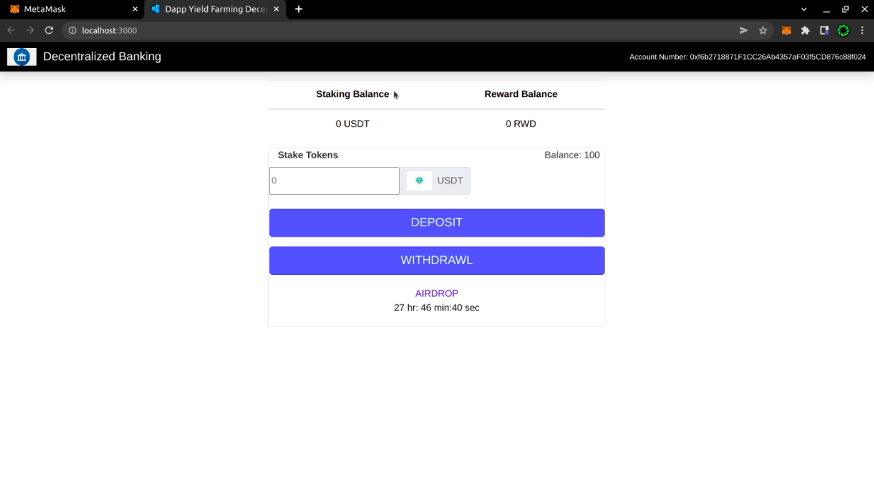

Slide 11
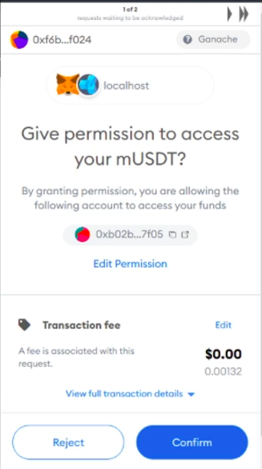
METAMASK WINDOW

Slide 12
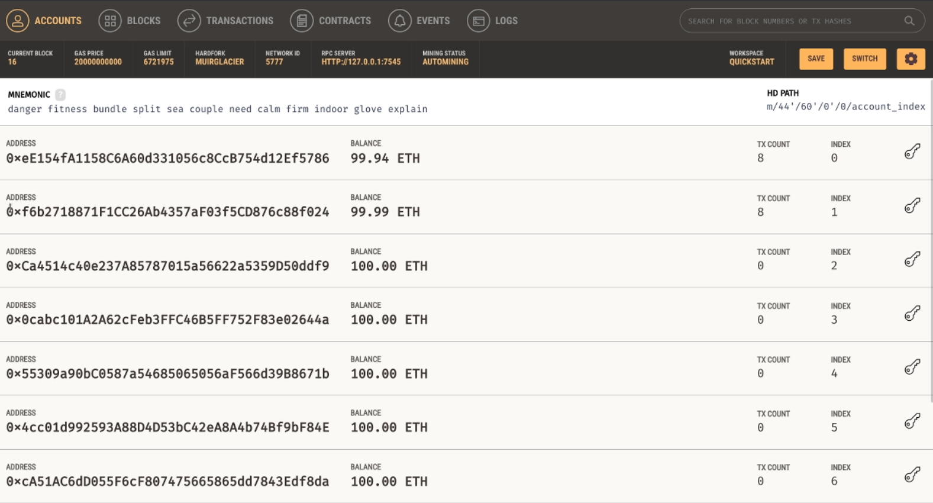
GANACHE WINDOW

Slide 13
Deposit Button:
It stakes the token from users balance to the decentral bank contract
Withdrawal Button:
It unstakes all the tokens that a user has submitted to the decentral bank contract
Airdrop Indicator:
It is a countdown timer that gets activated when a user has staked amount >= threshold amount
And when it hits 0 the rewards are awarded

Slide 14
TRUFFLE CONSOLE INTERACTION

Slide 15
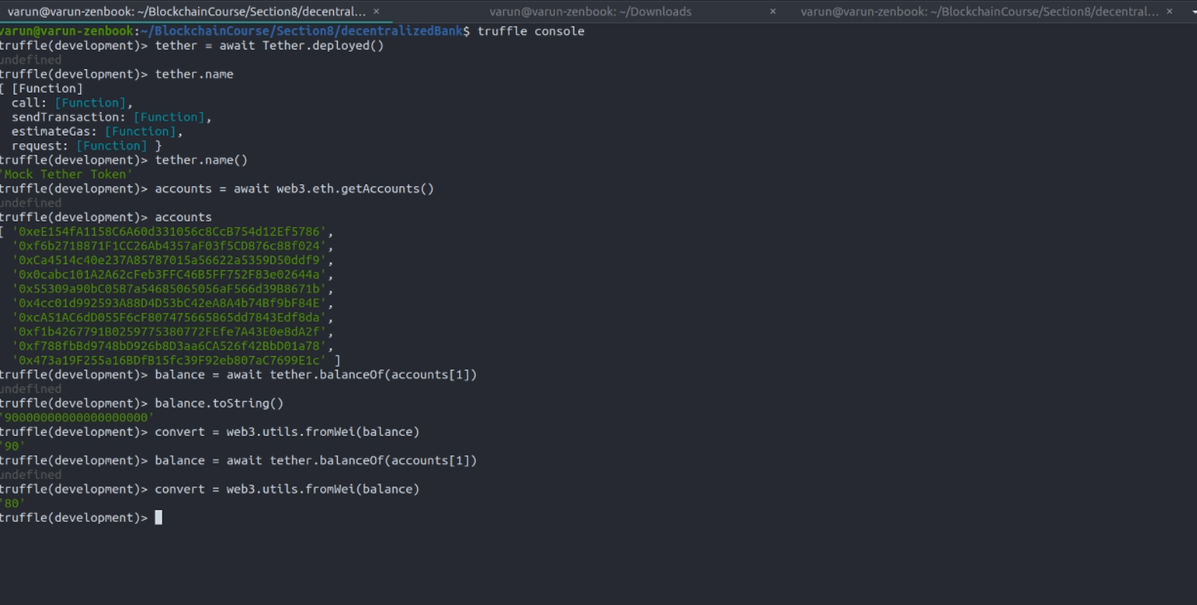
Accessing values from truffle console

Slide 16
TRUFFLE TESTS

Slide 17
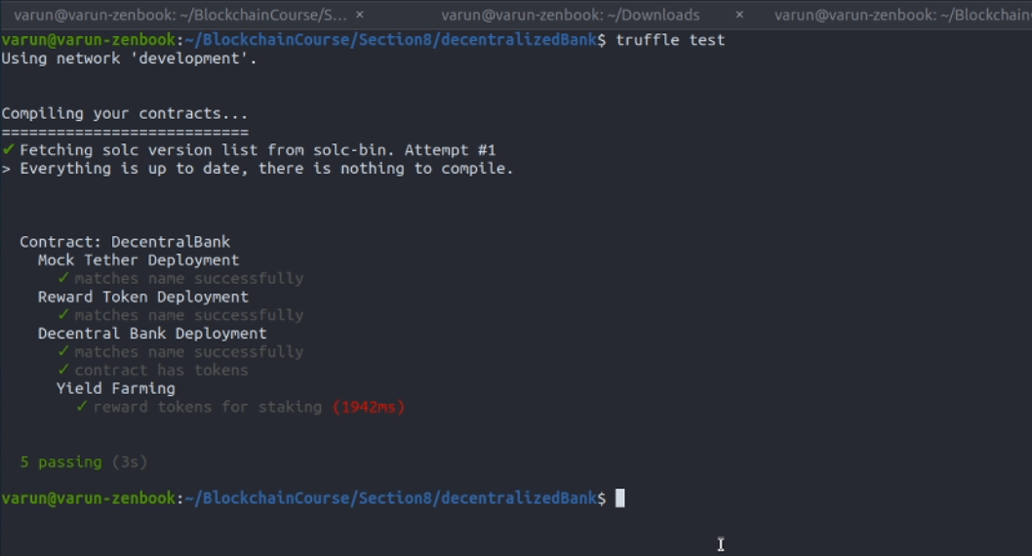
All the tests passed

Slide 18
CODE EXPLANATION

Slide 19
JS FILES:
1. App.js
First we do the task of loading web3 into the window.
Then we load the Blockchain data
For that we take web3 from the window and then fetch the networkID
Using that web3 and networkID we load the tether,rwd and decentralBank contracts, and set the states of respective variables that we will use to display in the front end.
We have a constructor which contains state variables, which will come pretty handy while implementation.
Finally, this App.js renders the MainContent
2. Navbar.js
This is just for the building of Navigating bar. We used React

Slide 20
JS FILES:
3. Main.js
This is for handling all the output to the FrontEnd
It contains the implementation of the buttons and it’s functionality.
4. Airdrop.js
We are using this for creating countdown timer for giving reward to someone that is staking in the decentral bank. It calls appropriate methods and assigns reward based on some function which takes stakedAmount as a parameter.
5. decentralBank.tests.js:
Used mocha and chai for testing.
Several assertions are tested within it for all the contracts built, and all of them passed

Slide 21
CONCLUSION

Slide 22
That is all the demonstration of the project. Now we will discuss the challenges we faced while implementing the whole project.
We needed to know how we were going to use the Eth network.
Since we had no idea, then we got to know that there are test networks for this development purposes. Then we decided to use Ganache for that.
We then needed to figure out how to implement the contracts, so we explored Solidity and then followed a few tutorials and learned about some of its good practices. Like, emit() and restrictions on who can call the method.
Another challenge was to know how to interact with the Ethereum nodes, for that we used Web3 which is a Javascript framework. And we fetched all the contracts, networkId and accounts via this.

Slide 23
Since debugging is hard in DApps, therefore we relied on testing using Mocha and Chai. We created some tests and checked whether the DApp is updating things on the network.
Before the UI construction, we relied heavily on the truffle console. We used various inbuilt methods and other things and kept cross-checking for the DApp functioning.
For the UI we depended on React a JS framework, we kept the UI minimal but it can be altered in future developments.
There are a few things that we can improve in the near future like we can add some additional functionality related to the transfer from one user to another user (we have not yet implemented this on UI but we worked on it through the truffle console).
And also the Airdrop feature can be improved further.

Slide 24
OUR TEAM
Varun Upadhyay, 2019285
Email- varun19285@iiitd.ac.in
Nikhil Kushwah, 2019260
Email- nikhil19260@iiitd.ac.in
Rohit Kumar Vishwas, 2019269
Email-rohit19269@iiitd.ac.in

Slide 25
Thank You!

Slide 26
BIBLIOGRAPHY
Image 1 Src
Image 2 Src
Image 3 Src
Image 4 Src
Image 5 Src
Image 6 Src
Image 7 Src
Image 8 Src
Image 9 Src

